Slide 1

Technical Table Top Meeting
April 18th, 2024, 14:00 - 16:00 (BST)

Slide 2
Agenda for Meeting
 | Topic | Slides
1 | Project Update & Goals of Meeting | 3
2 | Agreed Data Providers | 4
3 | Architecture Options: Overview of Sequence Diagrams | 5
4 | Four Sequence Diagrams | 6-10
5 | Data Discovery | 12
6 | Next Steps | 14

Slide 3
Project Update
Project Update:
We had a successful functional use case table top session on Friday 5th April
Use case doc: https://github.com/CDEIUK/pets-architecture/tree/main/Use%20Case
Architecture diagrams are here: https://github.com/CDEIUK/pets-architecture/tree/main/diagrams (as pdf & draw.io)
Parties:
Agreed US SEER dataset and NHS England NDRS data for scope of project and that data can be multi-modal in cases implementing federated learning
Goals of this Session
Walk through the functional use case determining possible logical implementation architectures
As guidance four separate sequence diagrams are provided to examine the different types of possible implementation together with benefits and assumptions
Get a close steer for the preferred logical architecture for further detailed analysis
Agree process for testing (stretch target and might be further workshop)
Agree next steps

Slide 4

Agreed Data Providers
US Data Provider:
NIH
SEER database
Access request process:
https://seer.cancer.gov/data/access.html
UK Data Provider:
NHS England
NDRS
Access request process:
https://digital.nhs.uk/services/data-access-request-service-dars

Slide 5
Architecture Options: Overview of Sequence Diagrams
 | Differential Privacy | Federated Learning | Fed Learning + Homomorphic Encryption | Secure Multiparty Computation
Delivers Functional Use Case | Yes, specifically privacy preserving statistical studies | Note, would only use Fed Learning together with Homomorphic Encryption | Yes, specifically collaborative machine learning models with multi-modal data | Yes, collaborative compute of statistical analyses and predictive models
Fully tests capability of PETs | Would not test collaborative machine learning models |  | Yes | Yes
Technical Benefits | Provides statistical analysis |  | Requires analysis of effectiveness on small datasets | Provides secure data sharing and requires analysis of scalability
Compliance with Privacy Regulation | Yes, GDPR & HIPAA |  | Yes, GDPR & HIPAA | Yes, GDPR & HIPAA

Slide 6
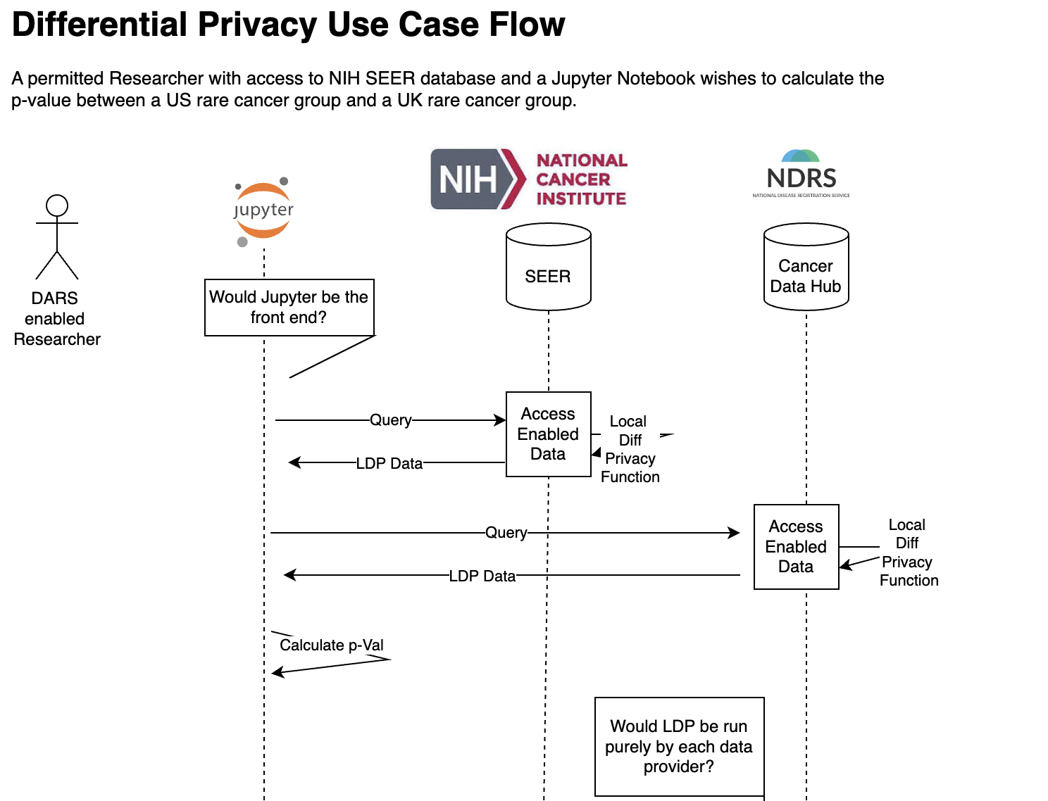
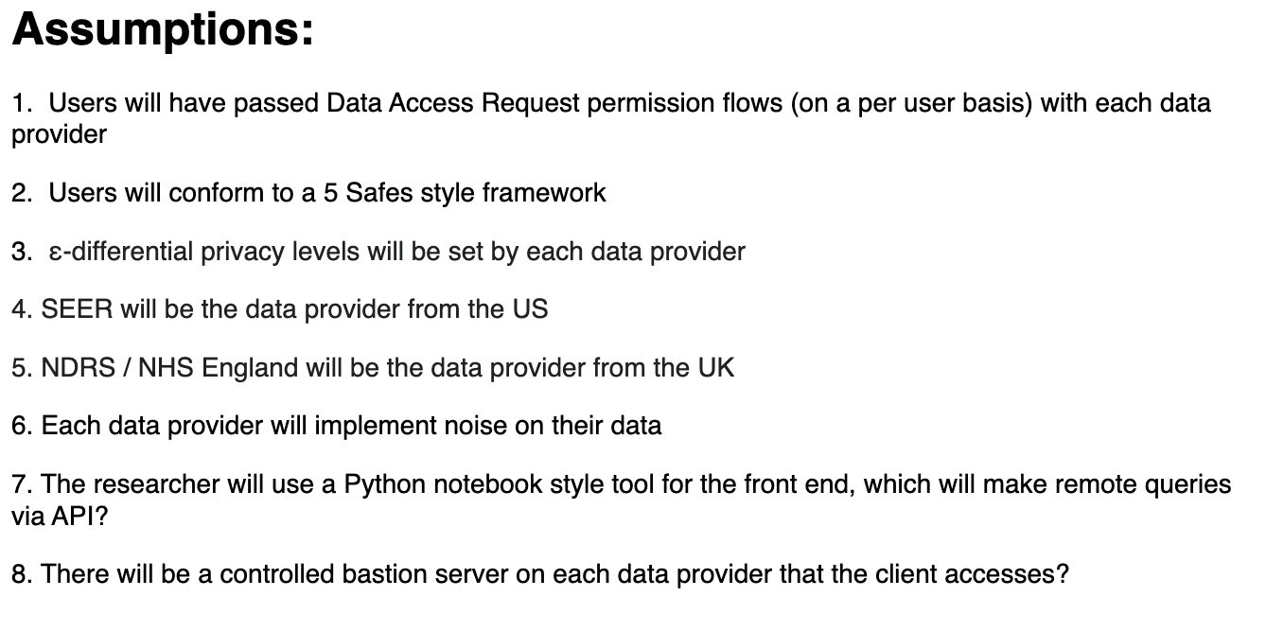
Differential Privacy Flow

Slide 7
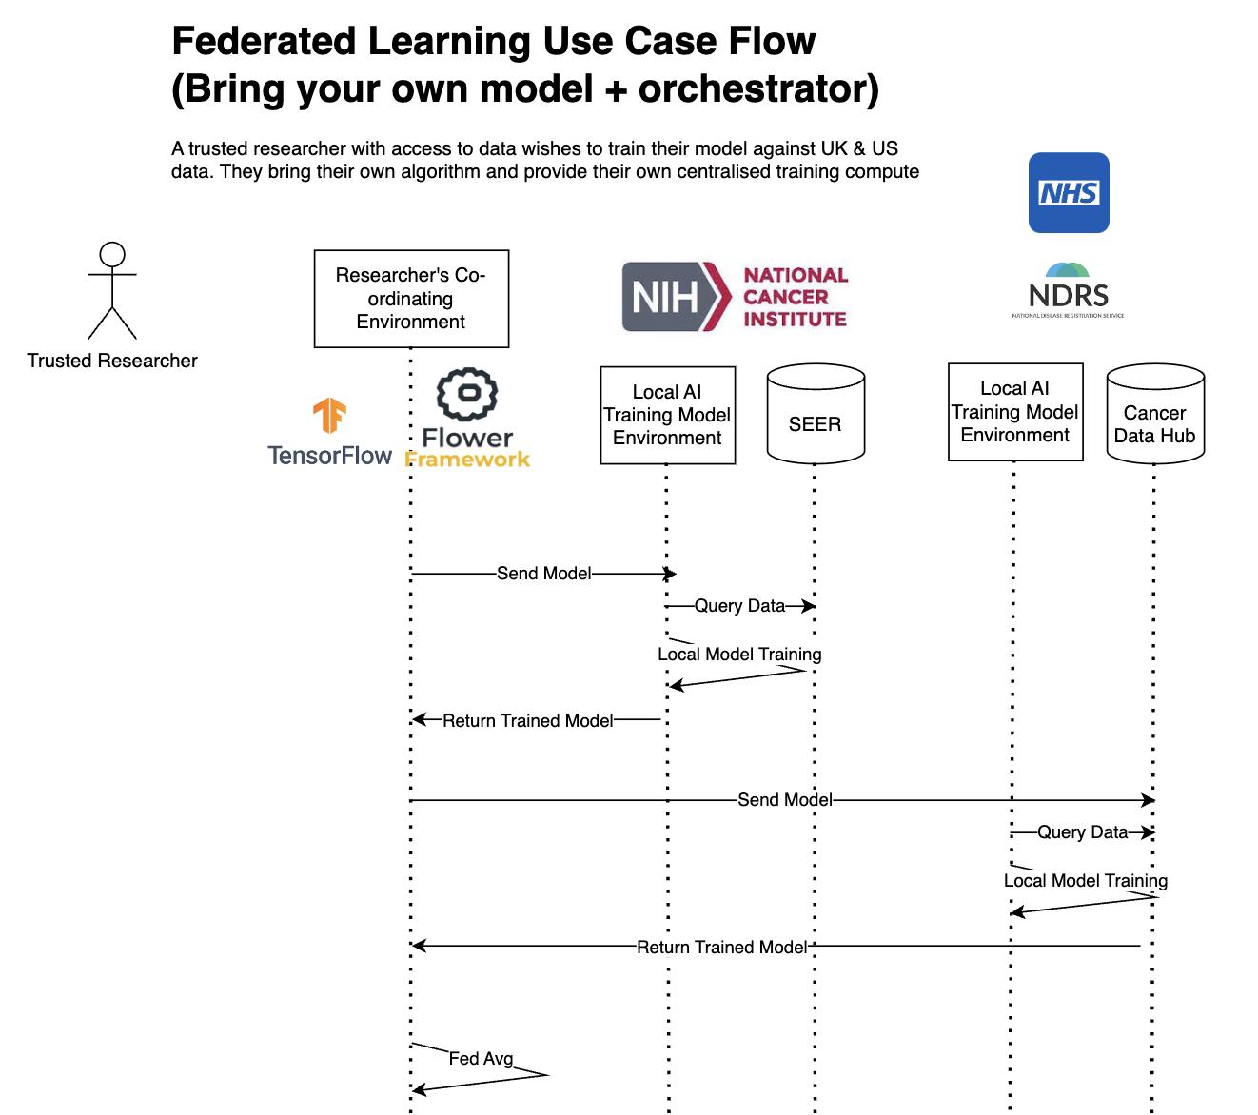
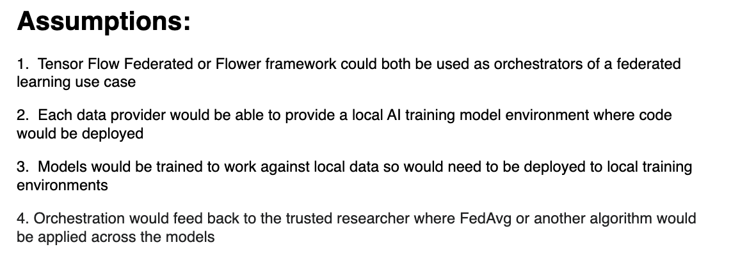
Federated Learning Flow

Slide 8
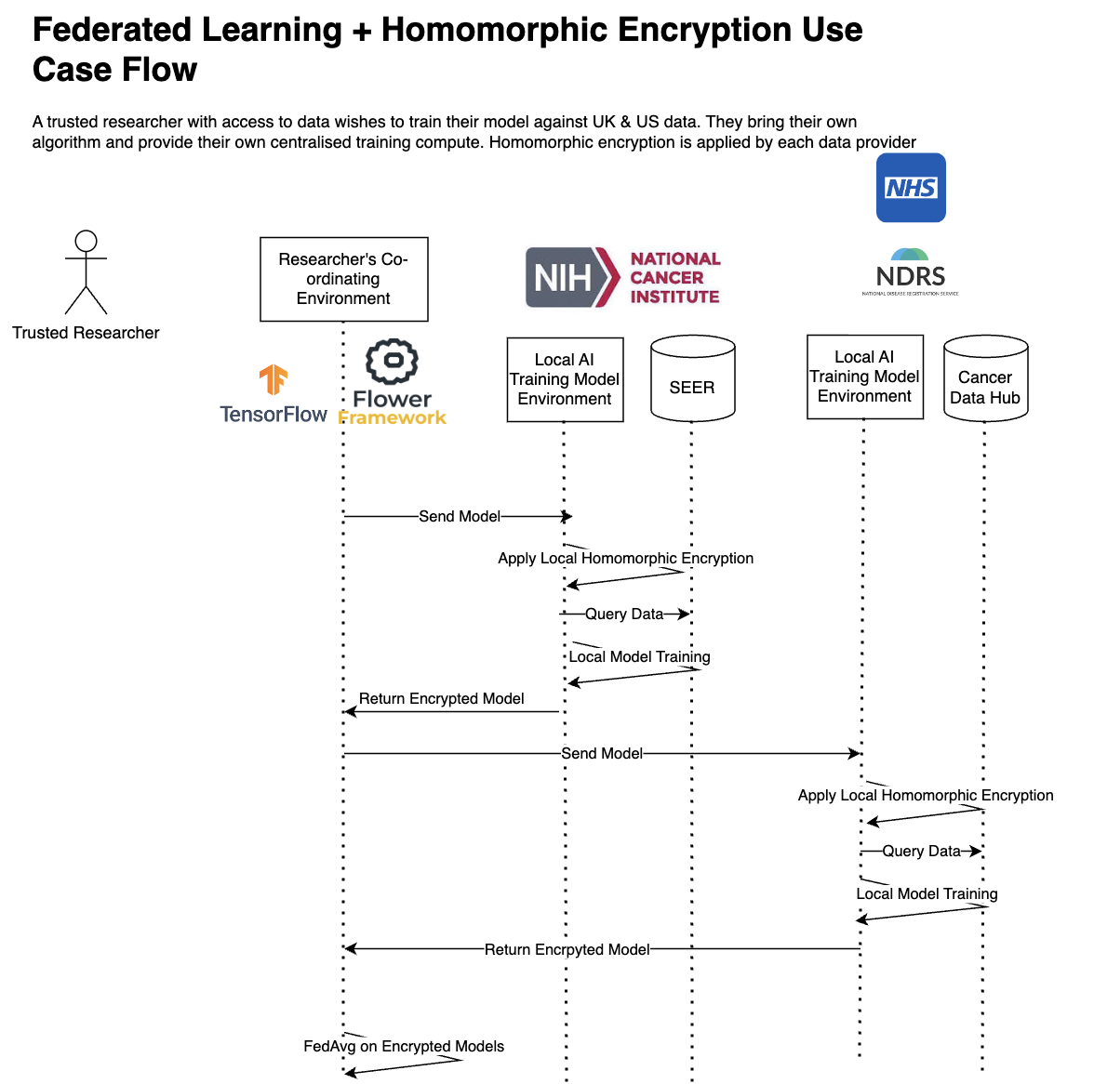
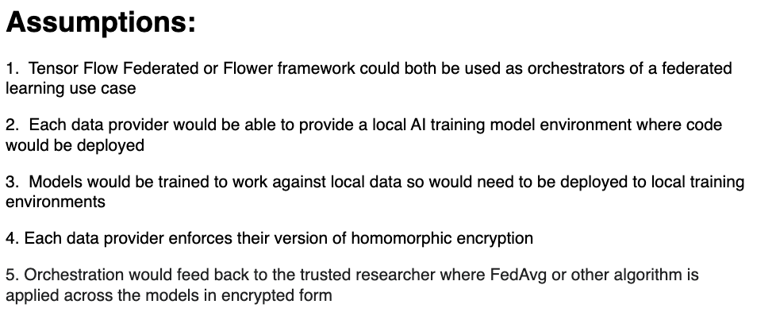
Federated Learning with Homomorphic Encryption Flow

Slide 9
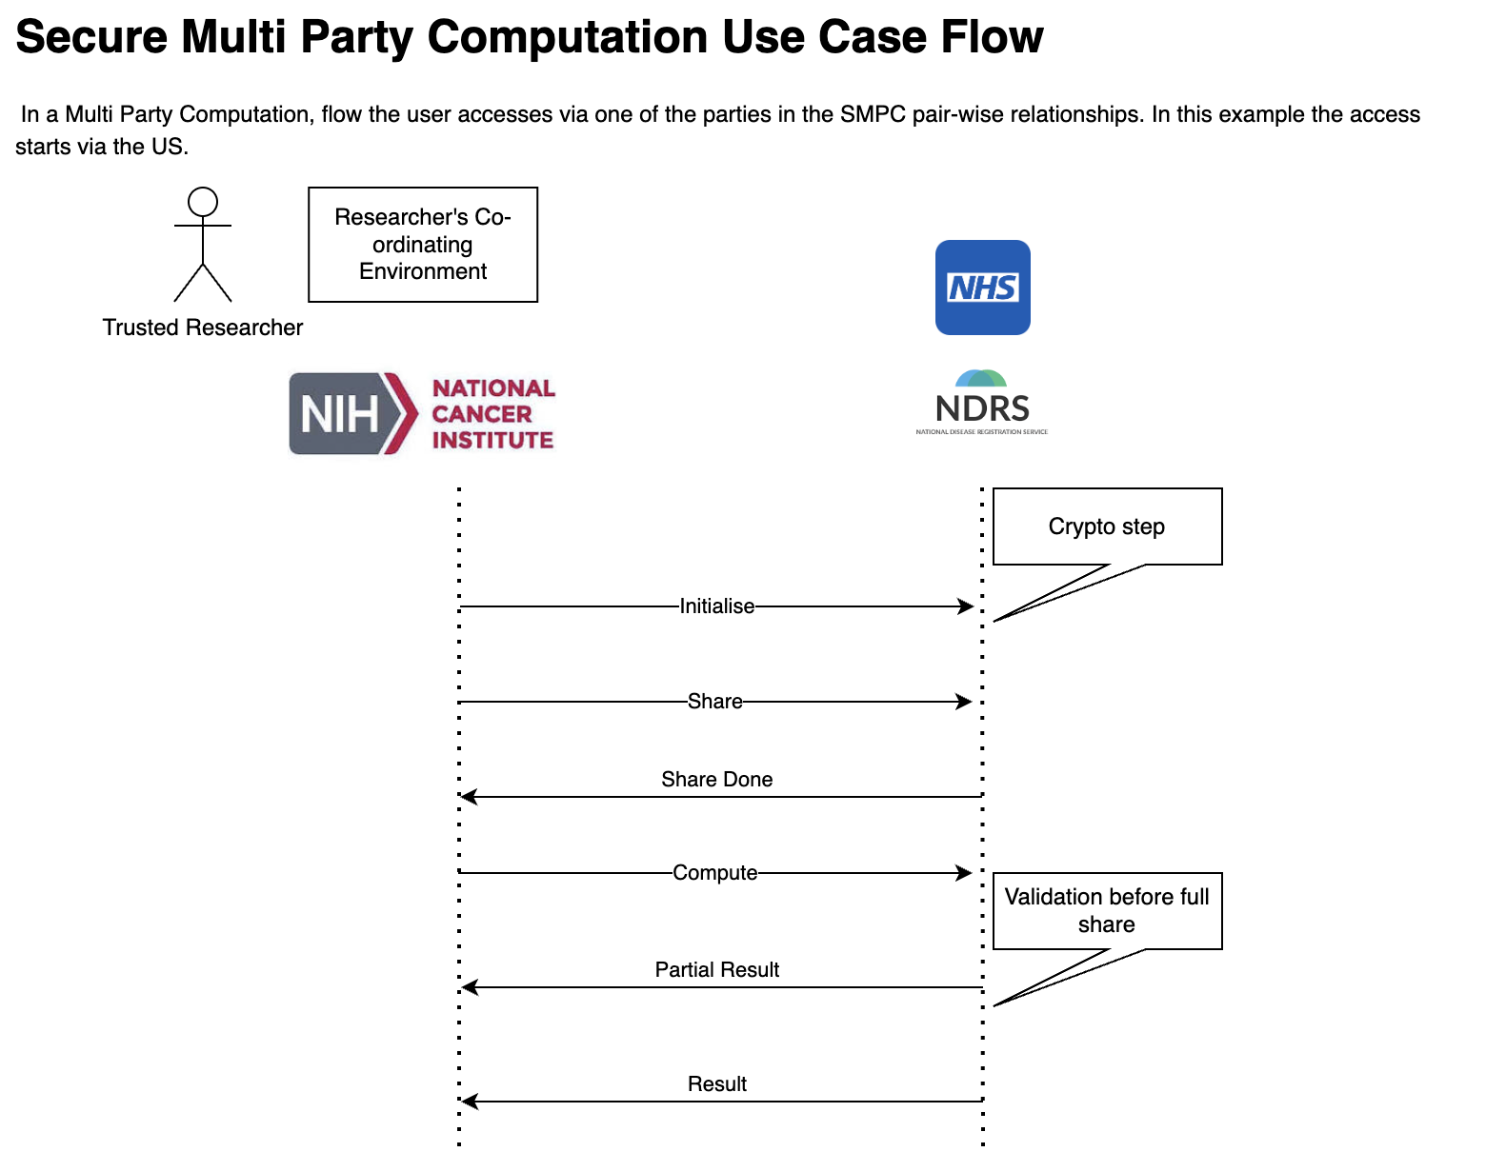
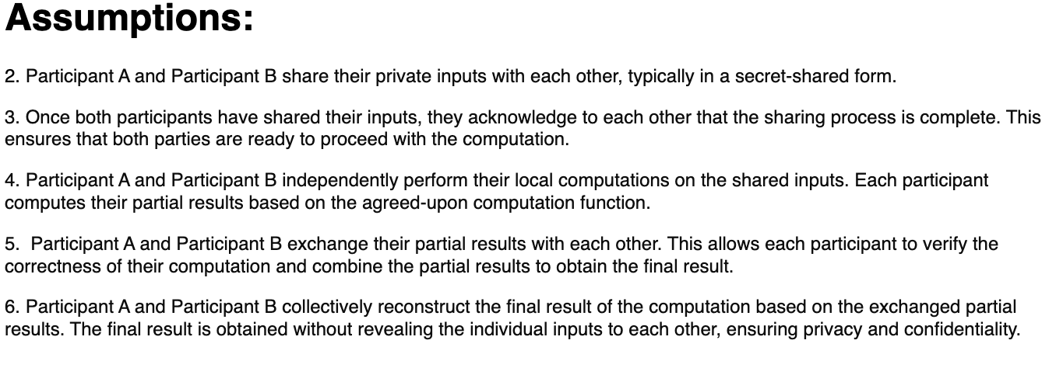
Secure Multiparty Computation Flow

Slide 10
Discussion on how to deliver use case
This is the main objective of this meeting is to discuss the functional use case with reference to the four possible architectures

Slide 11
Approach to Testing (for later discussion)
Any implementation with live data will require significant testing before go-live.
Testing will need to cover all the items listed on the following slide.
We suggest following a Test-Driven Development approach where the test requirements and test cases are fully documented and defined before the start of the implementation, thus allowing a better gated approval process.
We suggest that each data provider has their own Privacy Impact Assessment approach for vetting the implementation of other parties as part of their Data Access Request processes.

Slide 12
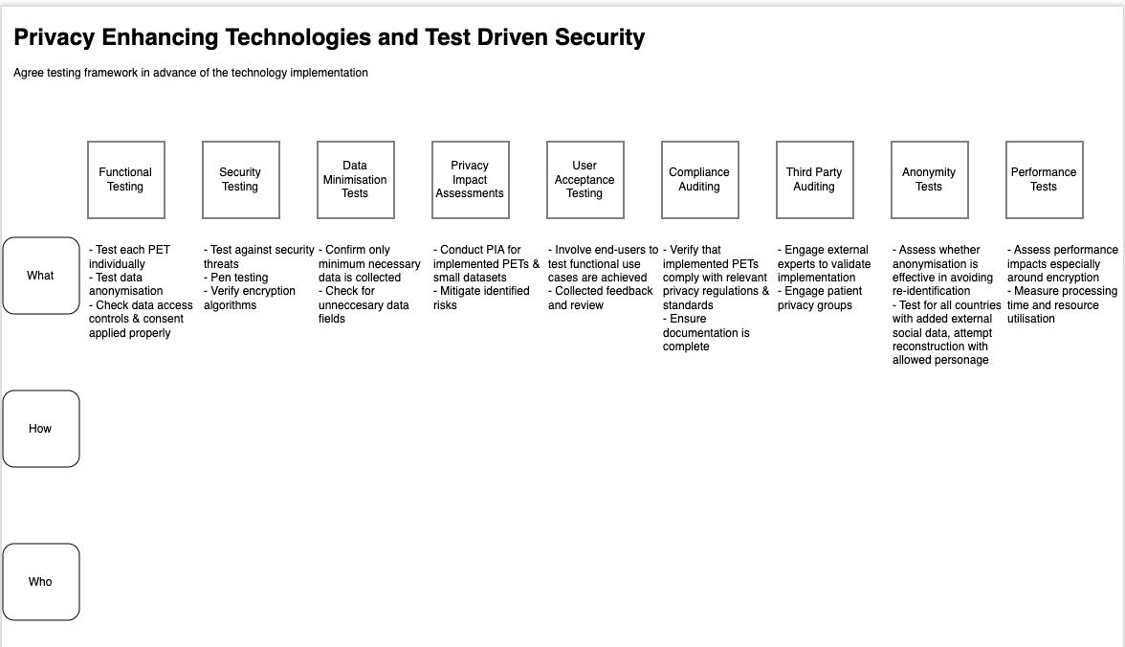
Approach to Testing (for later discussion)

Slide 13
RACI Matrix – please help complete
 | US |  |  |  |  | UK
Project Phases | NIH | NIST | NSF | NAACR | Oak Ridge | NHS England | NDRS | DSIT
Functional Use Case | R | C | C | C | C | C | R | C
Technical Use Case | R | C |  | C | I | R | R | C
Technical Test Cases | R | C | C | C | I | R | R | C
Data Access Request Process | R |  |  |  |  | R
Data Included in Project | R |  |  |  |  |  | R
MoU Between Parties
Vendor Selection Process
Technical Implementation
Technical Test Run with Synthetic Data
Proof of PET
Technical Test Run with Read Data
Go Live

Slide 14
Next Steps
What are the project next steps post agreement of the data providers, functional use case and technical architecture?

Slide 15
Version History
Version | Update | Feedback | Date
0.1 | First version – CG created with diagrams for use case flows |  | 14th April 2024
0.2 | Version 0.2 - BM updates. Sent out ahead of meeting |  | 17th March 2024

Slide 16
Reference: Types of PETs
Methods* | Description
K-anonymity & other anonymisation techniques | Given person-specific field-structured data, produce a release of the data with scientific guarantees that the individuals who are the subjects of the data cannot be re-identified while the data remain practically useful
Synthetic Data Generation | Artificial data mimicking real world datasets with applicability for transfer learning with real data
Central Differential Privacy (CDP) | Each individual submits their sensitive data to the data curator, who stores all of the data in a central location (i.e. on a single server). The data curator is trusted. The smallest amount of noise is added to the central data to produce results with the maximum accuracy allowed under differential privacy.
Local Differential Privacy (LDP) | As above except that each individual adds noise shifting the privacy barrier to the data provider. Increases the total amount of noise and reducing performance. Issues relating to
Hybrid Differential Privacy | Blended model with different Central & Local approaches per data provider along with approaches such as SMC or FHE
Homomorphic Encryption | Homomorphism in encryption allows operations to be performed directly on the encrypted data, eliminating the need to decrypt it first
Fully Homomorphic Encryption (FHE) | As per HE but enables AND, OR, XOR, NOT gates for computational logic
Secure Multiparty Computation (SMC) | distributes the private data to multiple computing parties in a form that does not reveal any sensitive information to either party as private data is kept confidential throughout the analysis. Less compute intensive than FHE but dependency of multiparty protocol enforcement. Lack of real world implementations.
Trusted Execution Environment (REE) | A Trusted Execution Environment (TEE) is a segregated area of memory and CPU that is protected from the rest of the CPU using encryption, any data in the TEE can't be read or tampered with by any code outside that environment. Data can be manipulated inside the TEE by suitably authorized code
Privacy Preserving Hardware | TEEs implemented in CPUs for data & processing integrity & confidentiality. Intel SGX, AMD SEV-SNP, ARM CCA
* Not mutually exclusive

Slide 17
Reference: Types of Use Case
Research Use Case* | Description
Secure Data Sharing and Collaboration | Secure sharing of patient data for collaborative research whilst maintaining patient confidentiality
Compliance with Privacy Regulations | Compliance with GDPR, HIPAA and other data protection laws
Condition Counts | Counts of specific conditions across pooled datasets
Genomic Counts | Counts of genetic SNPs across pooled datasets. Different genetic profiles across different populations.
Environmental Data Queries | Queries based on socio / economic / geographic / environmental data
Consent Management | Manage party consent with patient control of data access and purpose
Rare disease research | Rare condition (less than X globally per year)
Policy enforcement | Enforcement of security threshold level per data provider
Federated Machine Learning | Training of machine learning models across multiple datasets without data exchange
Global diseases surveillance and monitoring | Global disease surveillance to detect and predict outbreaks without data centralisation
Multi-national clinical trials | Analyse patient data from different countries for faster approval processes
* Not mutually exclusive

Slide 18
Reference: Types of Threat
Threats* | Description
Reconstruction Attacks | Reconstructing personal data from models and systems either through multiple calls, data injection or interception, or via different ML model security threats
Model Inversion Attacks | Reconstruct data from training data used in ML models
Membership Inference Attacks | Determining if a membership is part of a training dataset without having access to the data
* Not mutually exclusive

Slide 19
Reference: PET Types
Feature | Differential Privacy | Federated Learning + HE | Secure Multi-Party Computation
Privacy Preservation Method | Protects individual privacy by adding noise to data or query responses, ensuring that the presence or absence of any individual's data does not significantly impact the result. | Preserves individual privacy by allowing model training on decentralized data sources without sharing raw data, ensuring that sensitive information remains encrypted throughout the process. | Enables multiple parties to collaborate on data analysis without sharing sensitive information, ensuring that each party retains control over their data and that all computations are performed on encrypted data.
Data Sharing | Allows for sharing of aggregated data or query results while protecting individual privacy, facilitating collaborative research and analysis across different organizations or jurisdictions. | Enables collaborative model training on decentralized data sources without the need to share raw data, fostering collaboration and knowledge sharing while maintaining data privacy. | Facilitates secure data sharing and collaborative analysis among multiple parties, allowing distributed data to be aggregated and analysed without compromising individual privacy.
Model Training | Compatible with various machine learning models and algorithms, allowing for the training of predictive models while preserving privacy, even when using sensitive healthcare data. | Supports training of machine learning models on decentralized data sources, allowing for collaborative model development and improvement without sharing raw data or compromising privacy. | Enables collaborative training of machine learning models on encrypted data, ensuring that sensitive healthcare information remains protected while still allowing for model development and analysis.
Cross-Institutional Collaboration | Facilitates collaborative research efforts across different institutions, researchers, and healthcare providers by allowing the sharing of aggregated data or analysis results while protecting privacy. | Enables cross-institutional studies and research collaborations by allowing multiple organizations to contribute data for model training without sharing raw data, fostering collaboration while respecting data privacy. | Supports cross-institutional collaborations and research partnerships by enabling multiple parties to jointly analyze encrypted data without sharing sensitive information, promoting collaboration while maintaining privacy.
Regulatory Compliance | Helps researchers comply with data privacy regulations (e.g., HIPAA, GDPR) by providing a rigorous framework for protecting individual privacy while conducting analyses or sharing data. | Assists organizations in complying with data privacy regulations by allowing collaborative model training on decentralized data sources without the need to centralize or share raw data. | Aids organizations in adhering to data privacy regulations by enabling collaborative analysis and research on encrypted data, ensuring compliance while facilitating data sharing and collaboration.
Real-Time Monitoring and Response | Supports real-time monitoring and response to disease outbreaks, epidemics, and public health emergencies by allowing the analysis of aggregated data while protecting individual privacy. | Enables real-time monitoring and response to health threats by analysing decentralized data sources and aggregating model updates without sharing raw data, facilitating timely interventions while maintaining privacy. | Enables real-time monitoring and response to health emergencies by analysing encrypted data streams from multiple sources, providing insights while protecting individual privacy.
Ethical Consideration | Upholds ethical principles by protecting individual privacy and confidentiality while conducting research or analysis using sensitive healthcare data. | Respects individuals' rights to privacy and confidentiality by allowing collaborative research and analysis without exposing raw data to unauthorized parties, promoting ethical data handling practices. | Supports ethical data handling by ensuring that sensitive healthcare information remains protected during collaborative research and analysis efforts, aligning with ethical guidelines and principles.
* Not mutually exclusive

Slide 20
End

